Slide 1

MindConnect: An Integrated Mental Health Ecosystem
Raksha Krishna Moorthy- 002341520
Manvith Reddy Dalli - 002083515
Tanvi Reddy Bollavaram - 0028825648

Slide 2


Problem Defination
Patient Care Challenges
Healthcare Provider Issues
Insurance Processing Problems
Pharmacy Integration Issues

Slide 3
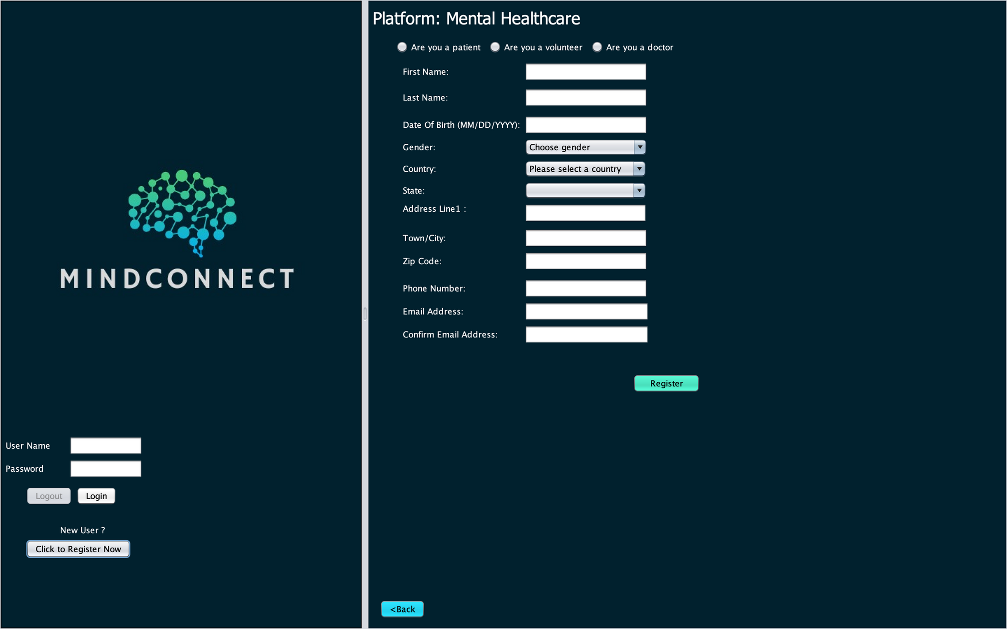
MindConnect: The Solution
1
Healthcare Access & Management Problems
2
Insurance Management Challenges
3
Administrative Inefficiencies
4
Pharmacy Integration Issues
Improves accessibility and efficiency
Simplifies insurance and funding
MindConnect creates a cohesive mental health support system by integrating key stakeholders and processes. This solution enhances accessibility, prioritizes urgent cases, and streamlines financial and administrative workflows, addressing the core challenges in mental health care delivery.

Slide 4
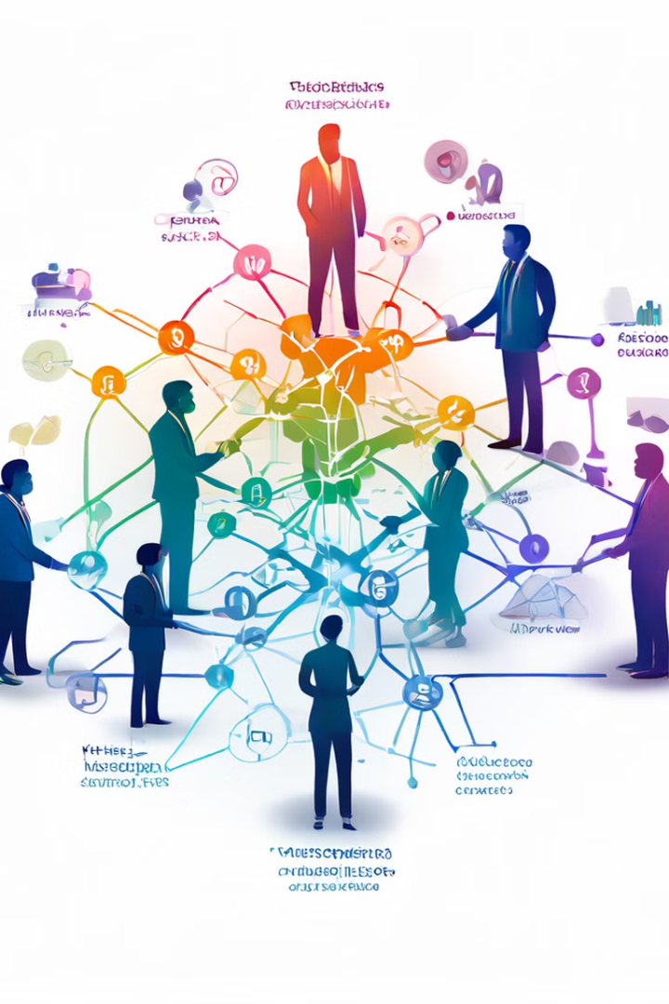
Approach
Enterprises
Roles
Government
Doctor
Hospital
Patient
Insurance Manager
Insurance
Insurance Company
Non-Profit
Government Sector
Department Admin
System Admin
Admin role
Organizations
Admin Organization
Corporate Insurance Providers Organization
Departmental Organization
Pharmacy Organization
Doctor Organization
Patient Organization

Slide 5
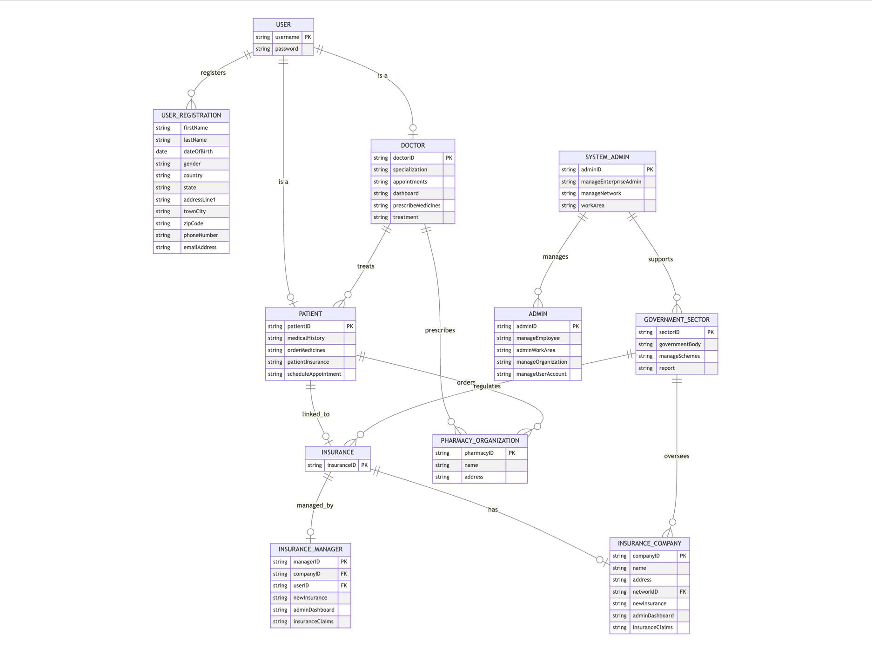
HIGH LEVEL CLASS DIAGRAM

Slide 6
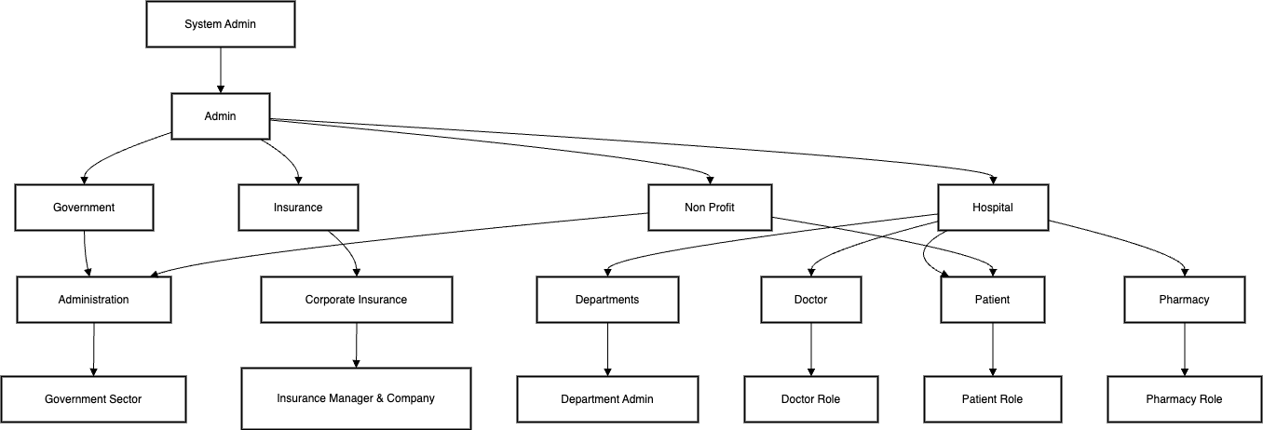
UML CLASS DIAGRAM

Slide 7

Use Cases
1. Mental Health Request
A student requests therapy for anxiety.
The system schedules an appointment with a doctor, who prescribes medicines accordingly
2. Government Scheme Management for Mental Health Services
A mental health portal needs a dedicated government sector interface to display and manage mental health welfare schemes available to citizens.

Slide 8

Glimpse of UI

Slide 9
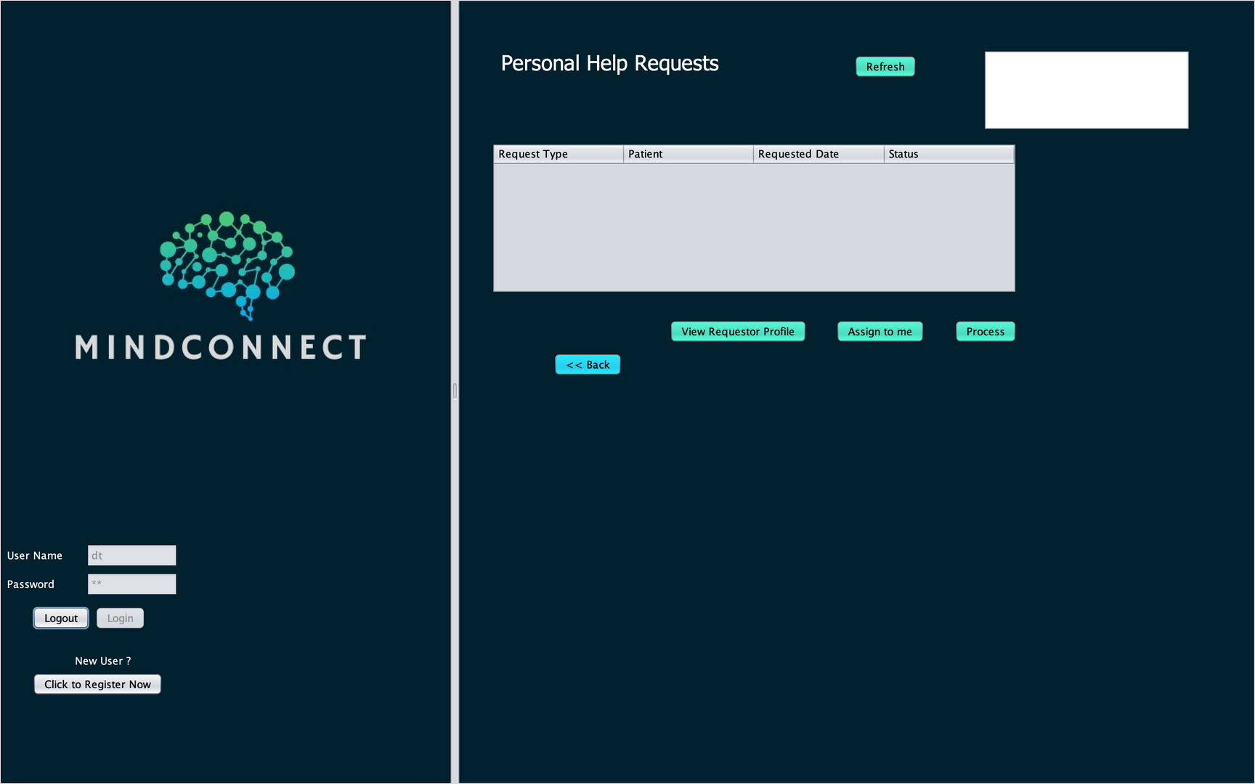
Glimpse of UI

Slide 10
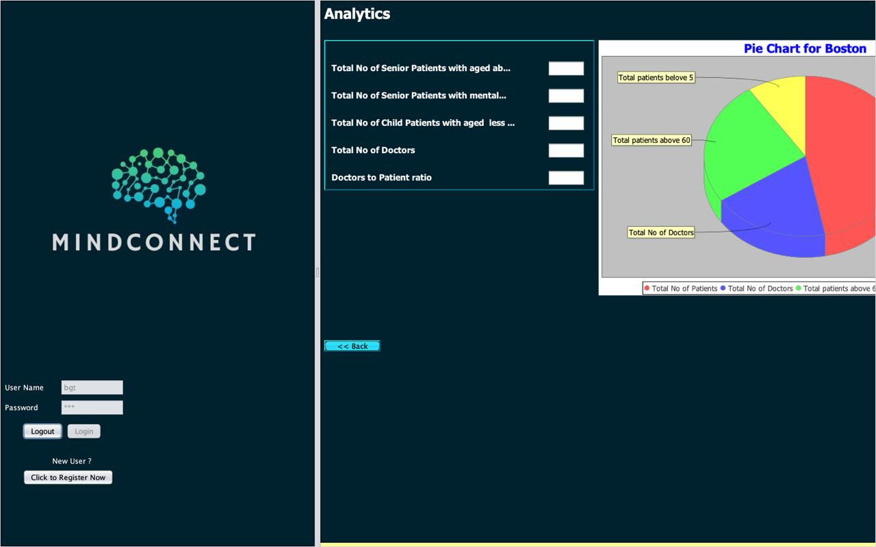
Glimpse of UI

Slide 11
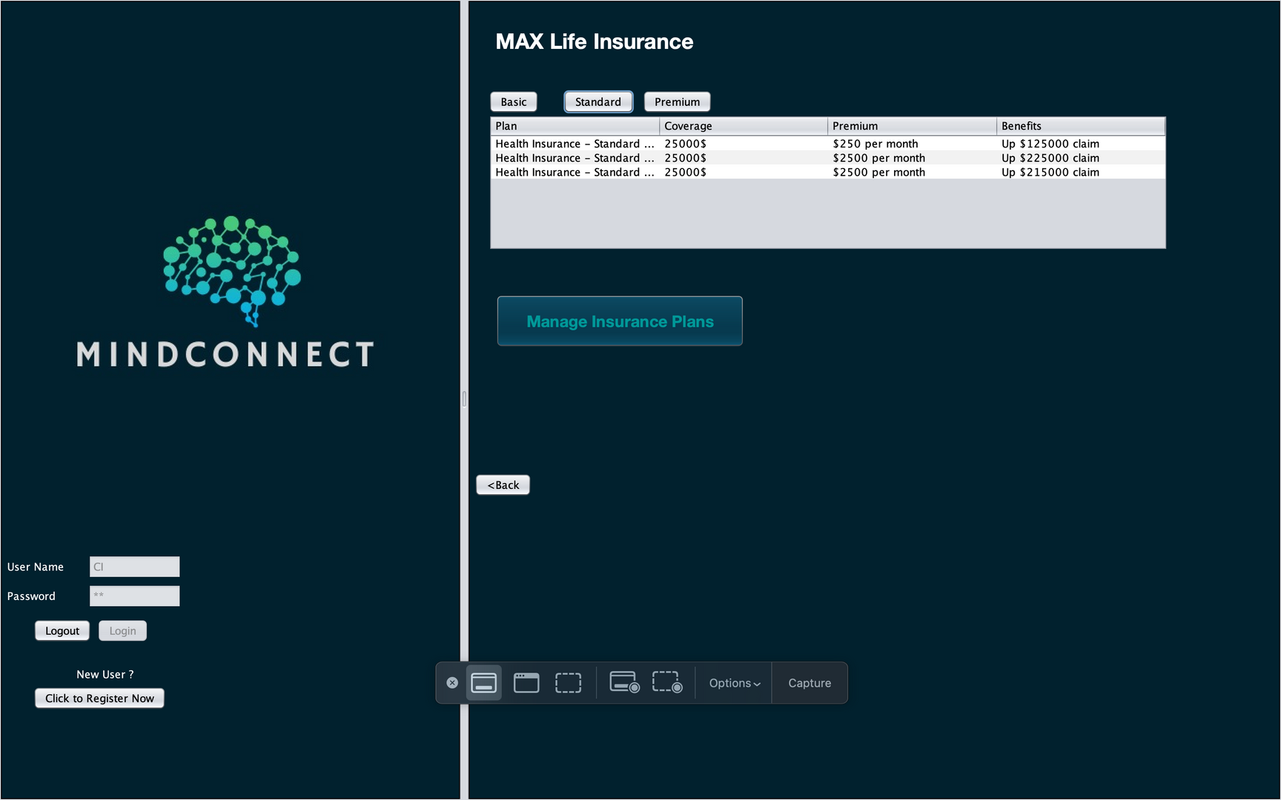
Glimpse of UI

Slide 12
Conclusion: Revolutionizing Mental Health Care
1
Bridge Gaps
Connect networks, roles, and organizations
2
Enhance Services
Provide timely, efficient, and affordable care
3
Promote Collaboration
Foster communication and shared resources
4
Ensure Equity
Deliver compassionate care for all
MindConnect will transform mental health care by creating a centralized ecosystem that addresses the current crisis with innovation and compassion. By implementing this platform, we can look forward to a future where mental health support is accessible, efficient, and equitable for everyone.

